Slide 1
Smart Sorting Transfer Learning for Identifying Rotten Fruits and Vegetables
BY
Mukesh Sunku
pola nanda kishore
nutakki mercy grace
NATUKULA CHAITHANYA KUMAR

Slide 2
Problem Statement
Problem of Spoilage: Identifying rotten produce is essential to reduce food waste, ensure consumer safety, and maintain product quality.
Solution via Transfer Learning: Use pre-trained deep learning models to classify images of fruits and vegetables as fresh or rotten, requiring less data and training time.
Need for Automation: Manual inspection of fruits and vegetables is slow, inconsistent, and not scalable for large supply chains.
Impact: Helps vendors, retailers, and distributors make faster, more accurate decisions, improving efficiency and reducing economic and health risks.

Slide 3
Objective
Leverage pre-trained convolutional neural networks (CNNs) to reduce training time and improve accuracy.
Perform classification with high precision and recall, even with limited labeled data.
Provide a scalable and efficient solution for real-time detection in agricultural and retail environments.
Assist in reducing food waste and improving quality control in the food supply chain.

Slide 4
Project Overview
Problem Identification: Manual detection of rotten fruits and vegetables is inefficient, inconsistent, and unsuitable for large-scale operations.
Proposed Solution: Use transfer learning with pre-trained CNN models to classify images of produce as fresh or rotten.
Efficiency & Accuracy: Transfer learning enables high accuracy even with limited data and reduces the need for extensive training from scratch.
Real-world Impact: Helps reduce food waste, improve quality control, and enhance decision-making in agriculture and retail sectors.

Slide 5
Dataset Overview
Sourced from Kaggle Fruit and Vegetable Disease (Healthy vs Rotten)
Resizing images to a fixed input size (e.g., 224x224 pixels).
Normalization and augmentation (rotation, flipping, zooming) to increase model generalization.
Splitting into training, validation, and test sets

Slide 6
Data Preprocessing
Image Resizing & Normalization: All images are resized (e.g., 224x224 pixels) and pixel values are scaled to [0, 1] for consistency and faster training
Label Encoding: Images are labeled as 'Fresh' or 'Rotten' and converted into numerical format using label or one-hot encoding.
Data Augmentation: Techniques like rotation, flipping, zooming, and brightness adjustment are applied to increase data variety and prevent overfitting.
Dataset Splitting: The dataset is divided into training, validation, and test sets (e.g., 70/15/15) to train and evaluate the model properly.

Slide 7
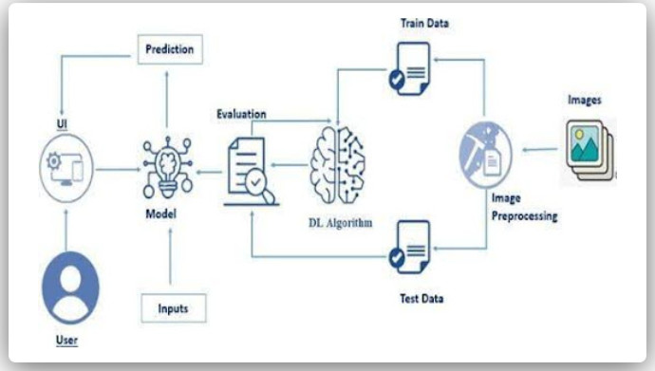
Model Architecture
Image Preprocessing
Data Splitting (Training and Testing)
Deep Learning Algorithm (Transfer Learning)
Model Evaluation and Prediction via UI

Slide 8
Training Strategy
Use of Transfer Learning
Freezing Base Model Layers
Fine-Tuning Top Layers
Batch-wise Training with Data Augmentation
Loss Function and Optimizer Selection
Early Stopping and Model Checkpointing
Validation during Training
Performance Metrics Monitoring

Slide 9
Application
Supermarkets and Retail Chains
Food Supply Chain and Warehousing
Smart Agriculture and Farming
E-commerce Grocery Platforms
Industrial Sorting Systems

Slide 10
Conclusion
This project successfully demonstrates the use of Convolutional Neural Networks (CNN) with transfer learning to accurately classify fruits and vegetables as fresh or rotten. By leveraging pre-trained models, the system achieved high performance with limited training data, reducing both time and computational cost. The approach proves to be effective, scalable, and applicable in real-world scenarios such as retail, agriculture, and supply chain management. Ultimately, this solution contributes to reducing food waste, improving product quality, and enhancing automation in food inspection processes.

Slide 11
Future work
Multi-Class Classification
Larger and More Diverse Datasets
Mobile and IoT Integration
Real-Time Detection System
Explainable AI (XAI)

Slide 12
THANK YOU

